Slide 1



Predictive Policing: Transforming Crime Analysis for Proactive Safety
By-Team Millennium HyperSpace

Slide 2

Problem Statement
Law enforcement agencies and communities often struggle to effectively analyze and utilize crime data to identify high-crime areas and implement proactive crime prevention measures. Traditional methods may be time-consuming and lack the ability to predict potential crime hotspots, leading to reactive rather than proactive approaches to law enforcement.
This problem statement is in compliance with the Goal 16 of Peace Justice and Strong Institutions

Slide 3

Challenges
💡 Lack of Predictive Analytics
💡Inefficient Data Analysis:
💡 Limited Community Engagement
Many existing systems focus on historical crime data but lack predictive analytics to anticipate future crime hotspots, making it challenging to implement preemptive strategies.
Law enforcement agencies may face challenges in efficiently analyzing and interpreting vast amounts of crime data, hindering their ability to identify patterns and trends.
Communities often lack accessible platforms to actively participate in crime prevention efforts or contribute local insights, hindering the collaborative aspect of community policing.

Slide 4
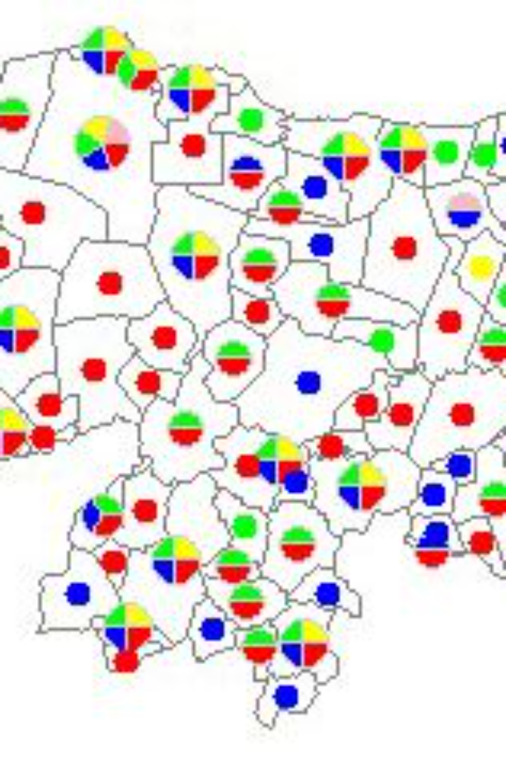
Solution
Crime Mapping and Prevention Platform
The proposed solution is a comprehensive Crime Mapping and Prevention Platform that leverages data analytics, machine learning, and community engagement to identify high-crime areas and facilitate proactive crime prevention measures.

Slide 5

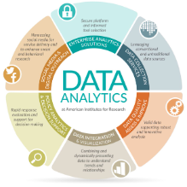
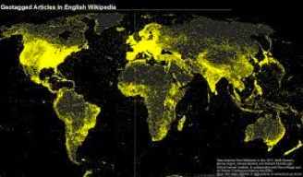

Implementation and Features
1
Data Integration:
Aggregate and integrate diverse sources of crime data, including police reports, incident logs, and community reports, into a centralized platform.
Geospatial Visualization:
2
Utilize geospatial mapping to visually represent crime data, allowing law enforcement and community members to identify crime trends and patterns in specific areas.
3
Community Reporting Interface:
Develop a user-friendly interface that allows community members to report suspicious activities or concerns directly onto the platform. Enable two-way communication between law enforcement and the community
Predictive Analytics:
4
Implement machine learning algorithms to analyze historical crime data and predict potential crime hotspots. This enables law enforcement to allocate resources more effectively and proactively address emerging trends.
5
Alert System:
Establish an alert system that notifies law enforcement and community stakeholders of predicted or reported crime hotspots. This ensures a timely and coordinated response to potential threats.

Slide 6


Tech Stack
Feasibility
Business Model
Data availability
Technology Integration
Freemium Model
Partnerships
Community Engagement
Workshops & Programs
Cost-Efficiency

Slide 7

CONCLUSION
By addressing these challenges and incorporating advanced technologies, the Crime Mapping and Prevention Platform aims to enhance overall safety and security, fostering a collaborative approach between law enforcement agencies and the communities they serve.
Our intention is not to create an atmosphere of fear but to help the society in the most feasible way and make it safe to the best extent possible.

